Slide 1


W9 Community Boosters Checklist
Training & empowerment cheat sheet for Community boosters
Version 1 – KOMYU

Slide 2
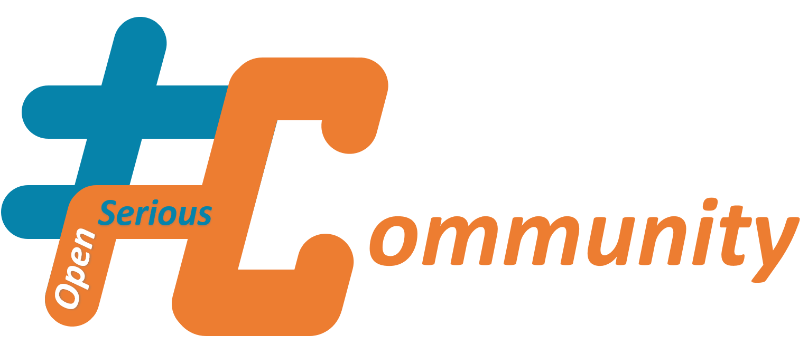
This document is a #OpenSeriousCommunity #OSC content
#OpenSeriousCommunity is a set of resources dedicated to helping to animate, grow, develop communities. The communities covered by #OpenSeriousCommunity can be just as much in the domain of the company, as of those of associations, institutions or private. The #OpenSeriousCommunity content follows the attributes of #OSG content, that-is-to-say it is open source and structured to promote maximum appropriation of the content for retransmission (further knowledge transfer). For more information, please visit https://www.openseriousgames.org/OpenSeriousCommunity (in French)

Slide 3

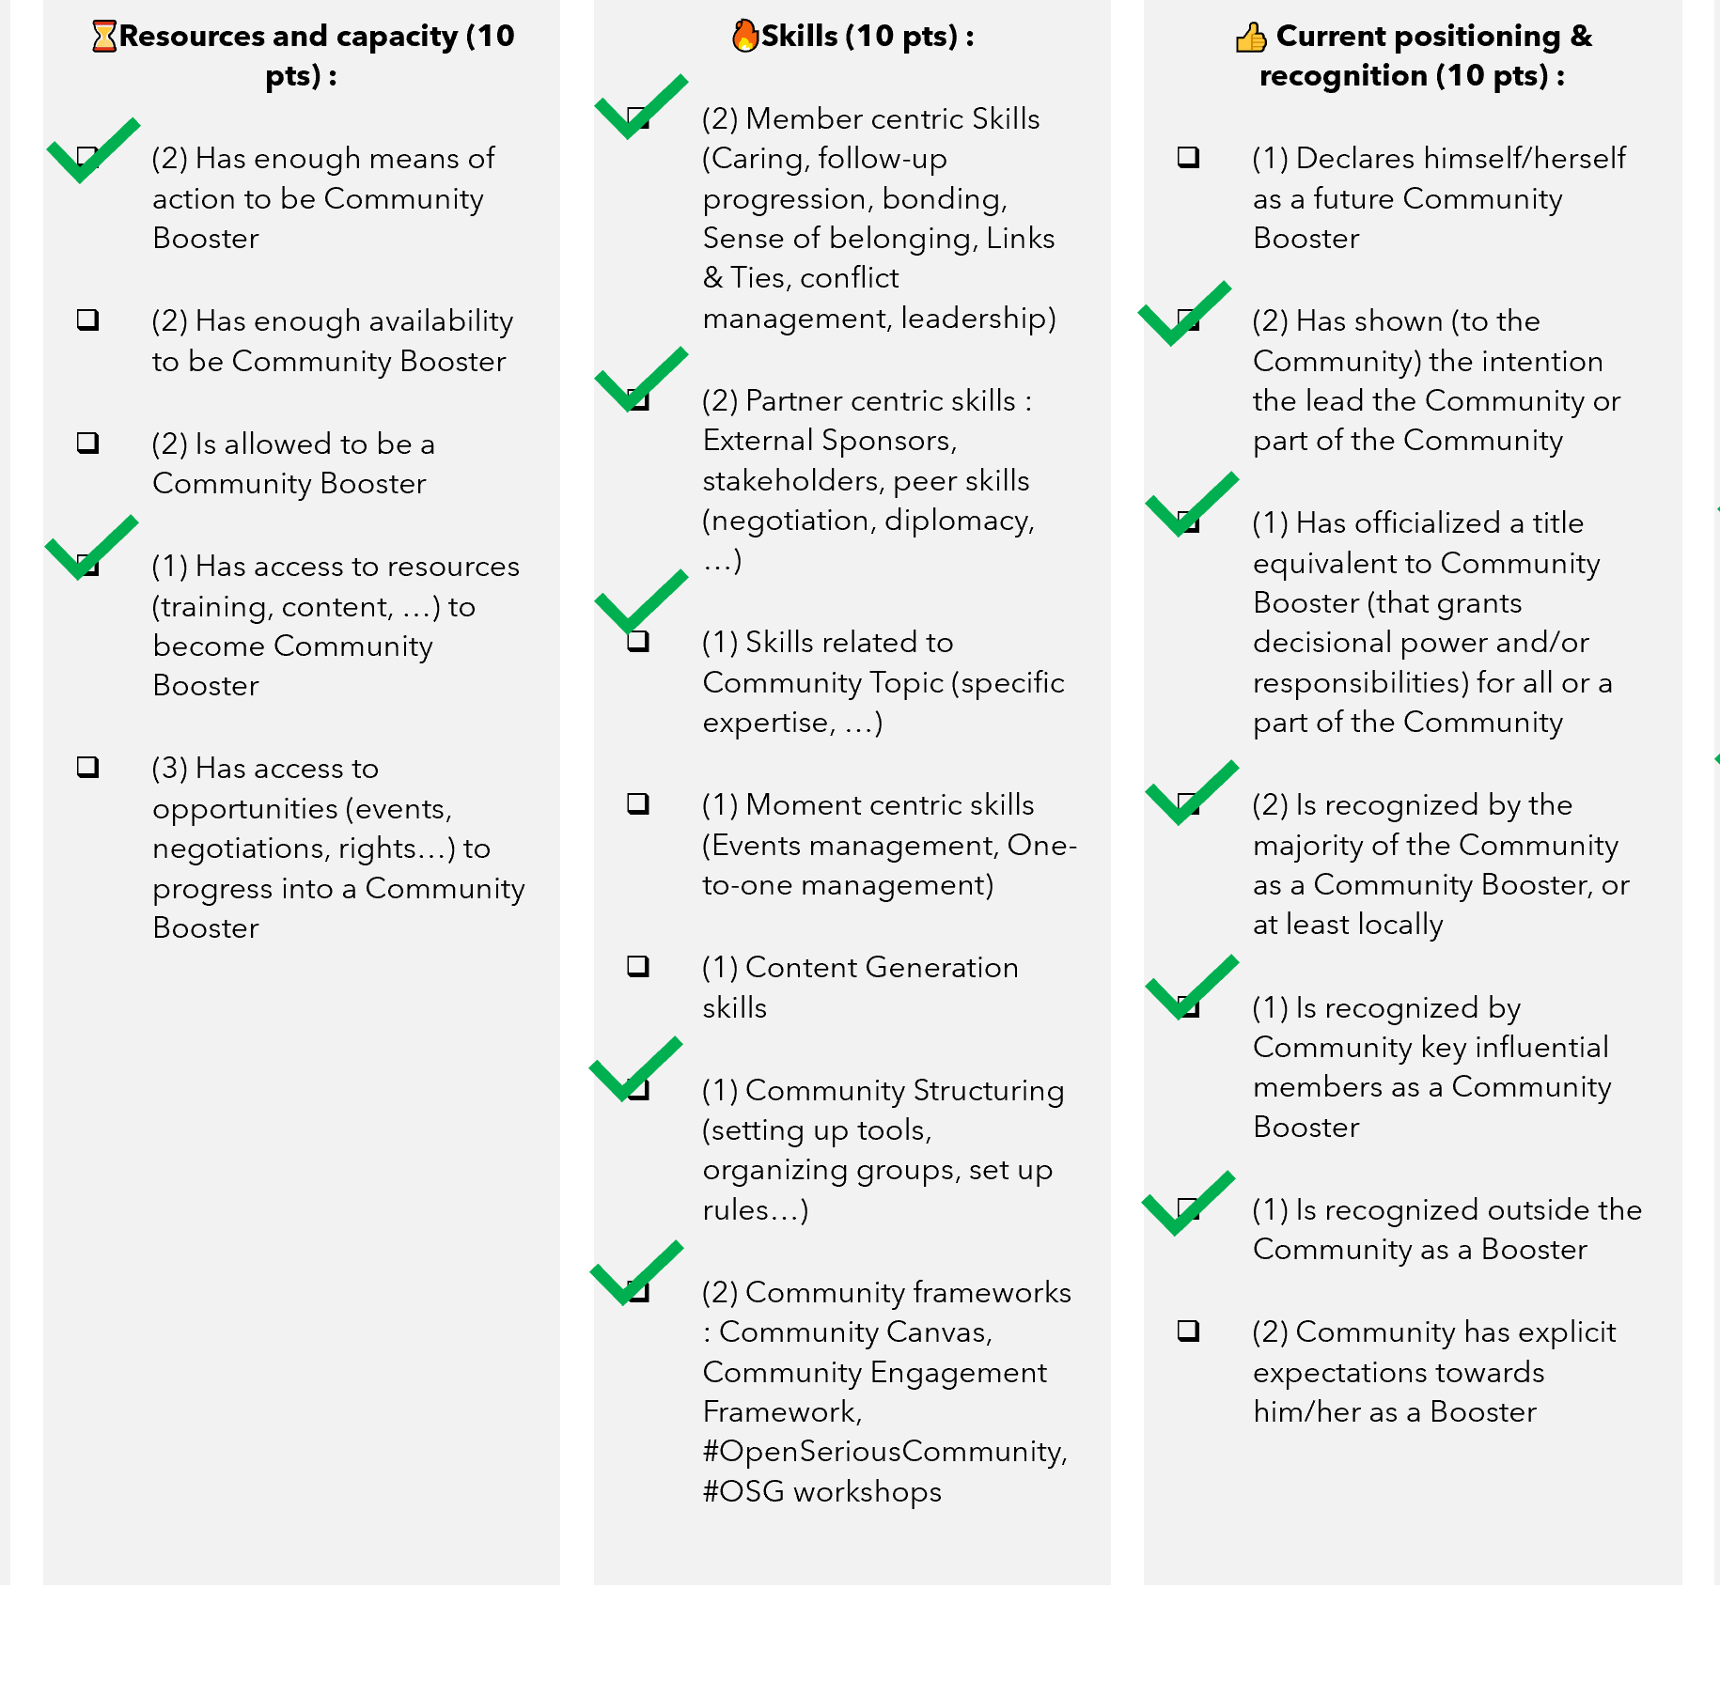
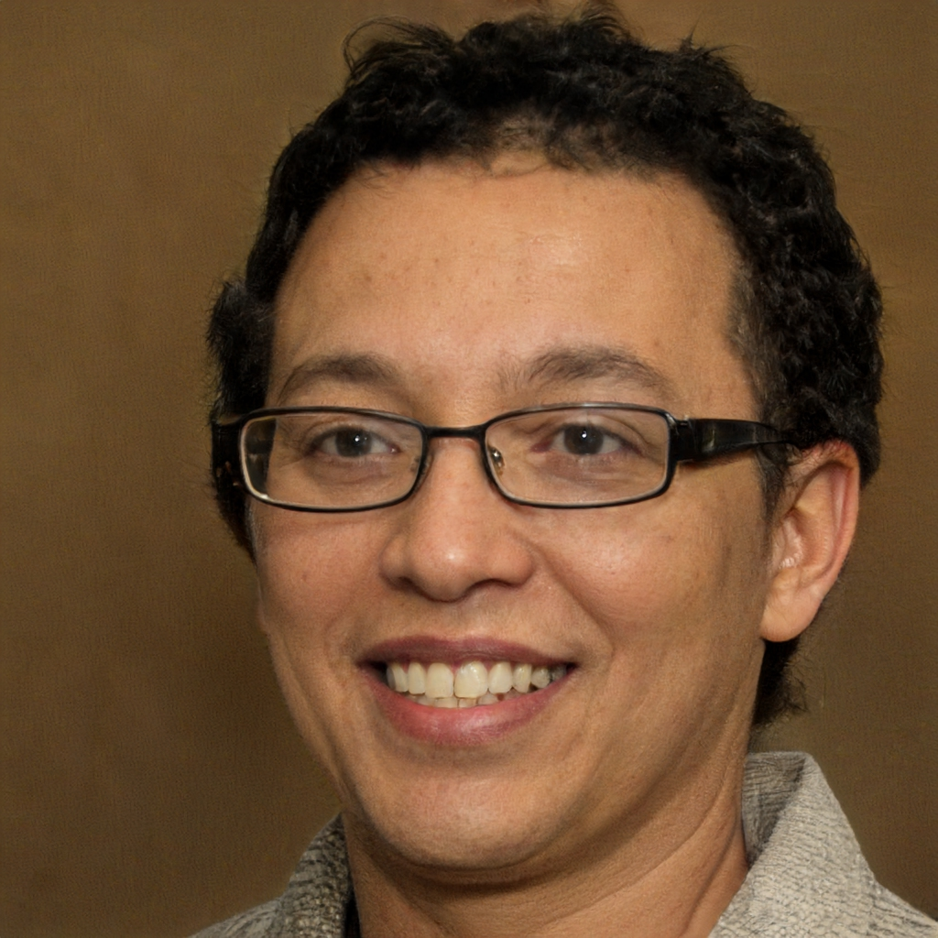
Community Boosters Checklists in a nutshell
Candidate or future Community Booster | Next moves / actions
Rick | 🎖️Achievements : Identify deeds to perform for the Community ⌛Resources and capacity : Negotiate with manager for availabilities to ramp-up
Share about the intention behind “checking” Boosters (improve position, plan coaching, find local boosters, …)
Together, mark the lists elements as ✔️OK or ⬜not and count points.
Display global result as a radar and discuss further steps

Slide 4
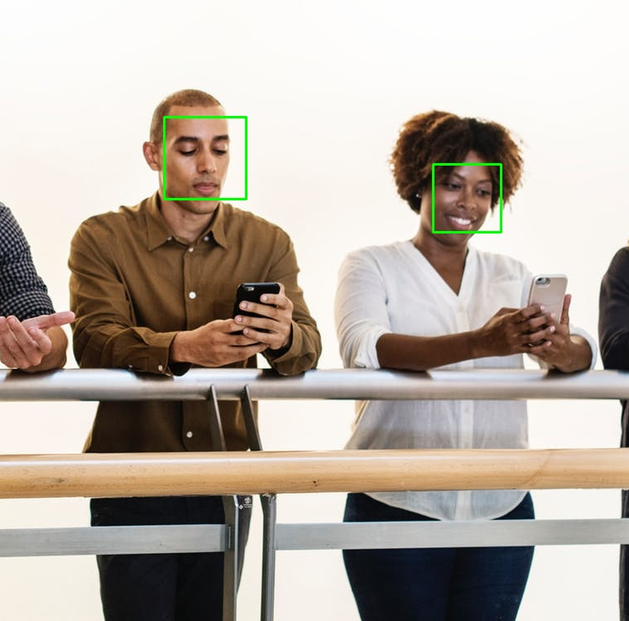


For whom and why have Community Boosters Checklists been created
Managers or Community Leaders looking for relays within the team or the Community, assessing various profiles to pick the best
Annual work focused interview for Community leaders or new Managers (assessment as leaders of their own team)
Inspiration base for Community leaders looking for continuous self-improvement in their role

Slide 5
Why Community Boosters checklists ?
Community Boosting (especially in a Corporate Environment) is a complex path.
One can find him/herself lost in this complexity or ignore what next steps could be performed to improve performance in the role.
Checklists are here to help navigating through this complexity.
Even if it will never be enough to summarize every situation and its specificities, these checklists can be a start. Feel free to adapt these lists by adding or removing fields.
Community Boosters checklists are used to assess “full role” boosters. It was not tailored for members with very specific roles within the Community.

Slide 6























🎯Usual goals when using Community Boosters checklists
In Communities : assessing who would be the right persons to lead subgroups and how to coach them into the role
In Communities : Follow-up sheet for any empowerment program for leaders
Treating a team as a Community, assessment of a manager legitimacy in his/her role.
When launching a Community, identifying who would stand out as a leader and how to support them

Slide 7
Community Boosters checklists Dimensions of assessment
🎯 Intention
Intention represents how much one wants to lead or boost a Community.
With high intention to develop oneself as a Community leader comes higher day-to-day motivation, energy and endurance.
Assessing intention helps in knowing mid to long term potential of a Community leader.
⌛Resources and capacity
Resources and capacity represent time, support, rights to assume the role of Community Booster.
While not sufficient by their own, resources and capacity can be the cause of either Community Booster comfort (if high) or fatigue (if low).
🔥Skills
Skills (Community Boosters Skills) represent an overall view of the usual skillset of a Community Booster.
Such skillset is of course “infinite”, and any Booster always has room for improvement. What is assessed in this category should be the “necessary minimum”, not the maximum one can obtain.
👍 Current positioning & recognition
Current positioning and recognition represent how members and stakeholders consider a Community Booster.
A highly trusted Community Booster is more likely to engage a Community and its stakeholders, while a lowly trusted booster has limited possibilities.
🎖️Achievements
Achievements of a Community Booster here represents his or her achievements that are related to the Community (actions inside and outside the Community, for the Community).
High achievements brings exemplarity and more respect from members and stakeholders, thus facilitating engagement.

Slide 8
Community Boosters checklists Example of grading system (using ✔️YES or ⬜NO)
🎯 Intention (10 pts) :
(2) Loves the Community
(2) Has interest in developing the Community
(2) Likes Community Development
(1) Has his/her own viewpoint about how the Community should evolve
(1) Has intention to self-develop (skills, wisdom, leadership…) through Community Boosting
(1) Makes room in his/her agenda for Community activities
(1) Is an active resource seeker for Community purposes
⌛Resources and capacity (10 pts) :
(2) Has enough means of action to be Community Booster
(2) Has enough availability to be Community Booster
(2) Is allowed to be a Community Booster
(1) Has access to resources (training, content, …) to become Community Booster
(3) Has access to opportunities (events, negotiations, rights…) to progress into a Community Booster
🔥Skills (10 pts) :
(2) Member centric Skills (Caring, follow-up progression, bonding, Sense of belonging, Links & Ties, conflict management, leadership)
(2) Partner centric skills : External Sponsors, stakeholders, peer skills (negotiation, diplomacy, …)
(1) Skills related to Community Topic (specific expertise, …)
(1) Moment centric skills (Events management, One-to-one management)
(1) Content Generation skills
(1) Community Structuring (setting up tools, organizing groups, set up rules…)
(2) Community frameworks : Community Canvas, Community Engagement Framework, #OpenSeriousCommunity, #OSG workshops
👍 Current positioning & recognition (10 pts) :
(1) Declares himself/herself as a future Community Booster
(2) Has shown (to the Community) the intention the lead the Community or part of the Community
(1) Has officialized a title equivalent to Community Booster (that grants decisional power and/or responsibilities) for all or a part of the Community
(2) Is recognized by the majority of the Community as a Community Booster, or at least locally
(1) Is recognized by Community key influential members as a Community Booster
(1) Is recognized outside the Community as a Booster
(2) Community has explicit expectations towards him/her as a Booster
🎖️Achievements (10 pts) :
(4) Has accomplished enough valuable actions for Community members
(2) Has accomplished enough promotional and external actions as a Community representative outside the Community
(3) Has accomplished enough valuable actions for key stakeholders or key influential members of the Community
(1) Has accomplished enough valuable actions for self thanks to the Community (can share about benefits of the Community for self)

Slide 9
Community Boosters checklists Example of grading system (using points)
🎯 Intention (10 pts) :
Loves the Community … /2
Has interest in developing the Community …/2
Likes Community Development …/2
Has his/her own viewpoint about how the Community should evolve .../1
Has intention to self-develop (skills, wisdom, leadership…) through Community Boosting …/1
Makes room in his/her agenda for Community activities …/1
Is an active resource seeker for Community purposes .../1
⌛Resources and capacity (10 pts) :
Has enough means of action to be Community Booster …/2
Has enough availability to be Community Booster …/2
Is allowed to be a Community Booster …/2
Has access to resources (training, content, …) to become Community Booster …/1
Has access to opportunities (events, negotiations, rights…) to progress into a Community Booster …/2
🔥Skills (10 pts) :
Member centric Skills (Caring, follow-up, bonding, Sense of belonging, conflict management, leadership) …/2
Partner centric skills : External Sponsors, stakeholders, peer skills (negotiation, diplomacy, …) …/2
Skills related to Community Topic (specific expertise, …) …/1
Moment centric skills (Events management, One-to-one management) …/1
Content Generation skills …/1
Community Structuring (setting up tools, organizing groups, set up rules…) …/1
Community frameworks : Community Canvas, Community Engagement Framework, #OpenSeriousCommunity, #OSG workshops …/2
👍 Current positioning & recognition (10 pts) :
Declares himself/herself as a future Community Booster …/1
Has shown (to the Community) the intention the lead the Community or part of the Community …/2
Has officialized a title equivalent to Community Booster (that grants decisional power and/or responsibilities) for all or a part of the Community …/1
Is recognized by the majority of the Community as a Community Booster, or at least locally …/1
Is recognized by Community key influential members as a Community Booster …/1
Is recognized outside the Community as a Booster …/1
Community has explicit expectations towards him/her as a Booster …/2
🎖️Achievements (10 pts) :
Has accomplished enough valuable actions for Community members …/4
Has accomplished enough promotional and external actions as a Community representative outside the Community …/2
Has accomplished enough valuable actions for key stakeholders or key influential members of the Community …/3
Has accomplished enough valuable actions for self thanks to the Community (can share about benefits of the Community for self) …/1

Slide 10
Community Boosters checklists Tips on assessment
All words can have multiple interpretations, be sure to share about what everyone understands behind a given criterium, especially in case of disagreement of score.
Feel free to remove lines that you do not understand or that you consider useless in your context (for example, if there are no use for content generation in your Community, remove the “Content generation skills” line)
Change the number of points if necessary, or if you consider a given criterium more important or less important than in the default sheet
Add lines and criteria you consider relevant for your situation.
A recommended assessment format is given below. These are recommendations, not mandatory paths.

Slide 11

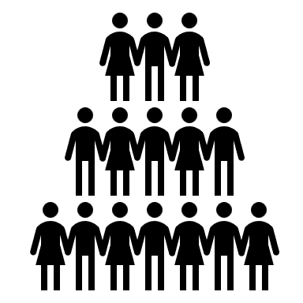



Community Boosters checklist Recommended assessment format
Community Data & Community Metrics
Forms or questions to Community members
Assessment by a third party (peer, manager, key community member…)
Difficulty & cost of assessment
Community Booster self assessment
🎖️Achievements
👍 Current positioning & recognition
🔥Skills
⌛Resources and capacity
🎯 Intention

Slide 12

Community Boosters checklist Example of result
🎯 Intention (10 pts) :
(2) Loves the Community
(2) Has interest in developing the Community
(2) Likes Community Development
(1) Has his/her own viewpoint about how the Community should evolve
(1) Has intention to self-develop (skills, wisdom, leadership…) through Community Boosting
(1) Makes room in his/her agenda for Community activities
(1) Is an active resource seeker for Community purposes
⌛Resources and capacity (10 pts) :
(2) Has enough means of action to be Community Booster
(2) Has enough availability to be Community Booster
(2) Is allowed to be a Community Booster
(1) Has access to resources (training, content, …) to become Community Booster
(3) Has access to opportunities (events, negotiations, rights…) to progress into a Community Booster
🔥Skills (10 pts) :
(2) Member centric Skills (Caring, follow-up progression, bonding, Sense of belonging, Links & Ties, conflict management, leadership)
(2) Partner centric skills : External Sponsors, stakeholders, peer skills (negotiation, diplomacy, …)
(1) Skills related to Community Topic (specific expertise, …)
(1) Moment centric skills (Events management, One-to-one management)
(1) Content Generation skills
(1) Community Structuring (setting up tools, organizing groups, set up rules…)
(2) Community frameworks : Community Canvas, Community Engagement Framework, #OpenSeriousCommunity, #OSG workshops
👍 Current positioning & recognition (10 pts) :
(1) Declares himself/herself as a future Community Booster
(2) Has shown (to the Community) the intention the lead the Community or part of the Community
(1) Has officialized a title equivalent to Community Booster (that grants decisional power and/or responsibilities) for all or a part of the Community
(2) Is recognized by the majority of the Community as a Community Booster, or at least locally
(1) Is recognized by Community key influential members as a Community Booster
(1) Is recognized outside the Community as a Booster
(2) Community has explicit expectations towards him/her as a Booster
🎖️Achievements (10 pts) :
(4) Has accomplished enough valuable actions for Community members
(2) Has accomplished enough promotional and external actions as a Community representative outside the Community
(3) Has accomplished enough valuable actions for key stakeholders or key influential members of the Community
(1) Has accomplished enough valuable actions for self thanks to the Community

Slide 13
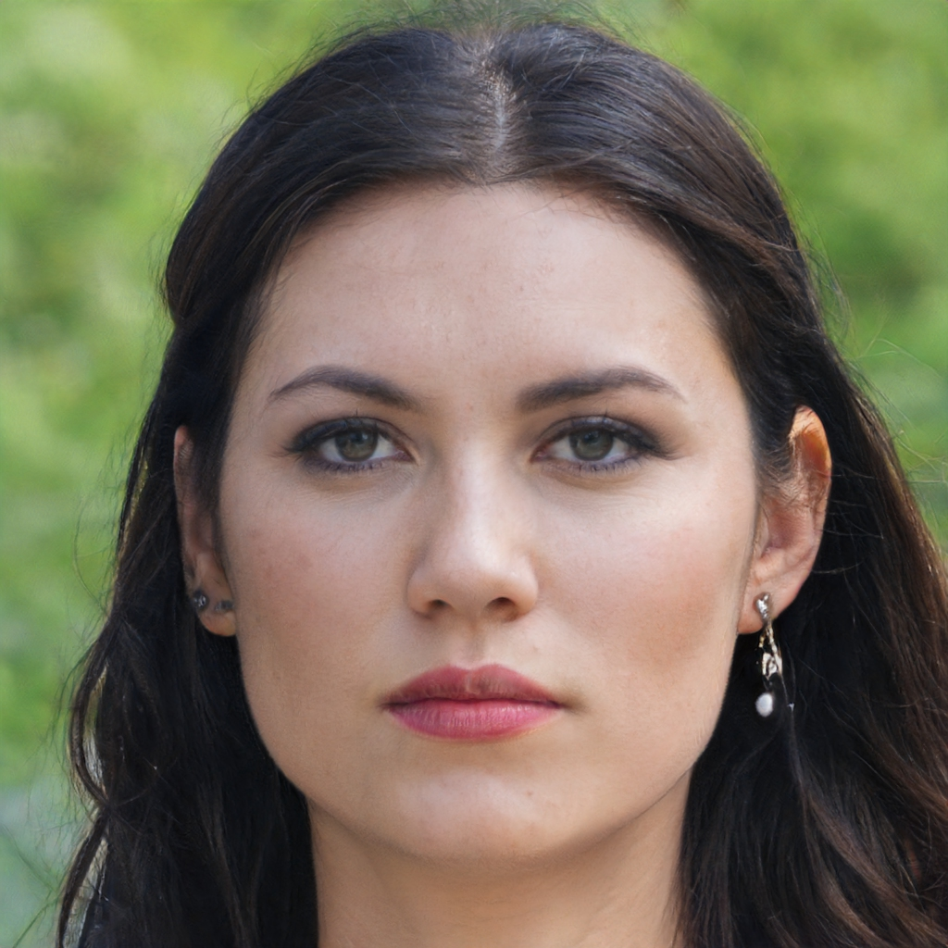
Community Booster checklists Using the checklists results
Candidate or future Community Booster | Next moves / actions
Rick | 🎖️Achievements : Identify deeds to perform for the Community ⌛Resources and capacity : Negotiate with manager for availabilities to ramp-up
Donna | 🔥Skills : Organize training on Community Canvas 👍 Current position & recognition : Officialize her role as a Community Booster trainee
Rick is skilled and recognized as a potential leader but has a low availability and has not achieved anything significant for the Community yet.
Donna is motivated and has already contributed to the Community. She also has time to ramp-up. However, she lacks official recognition for the moment and skills for a future position.

Slide 14
Community Boosters Checklists as a workshop for Subcommunities boosters
There can be various uses of this checklist, only one of them will be described in this document.
The following slides describe how a Community booster, along with sponsors and decision makers, can organize a workshop to assess together
WHO would be the best candidates to become a Subcommunity Booster (Community Booster of a subcommunity).
HOW to help them assume the roles given their assessment
The workshop described here fits the phase 3 of the 5-phase Community Development model in #OpenSeriousCommunity
In the checklist, feel free to adjust the word “Community” and change it to “Subcommunity” if you plan to pick profiles for subcommunities boosters

Slide 15



This workshop is an #OpenSeriousGame
It is made so that you can host and share it after discovering it as a participant
All the material to promote, animate, adapt, create variants is at your disposal.
One day, it will be up to you to transfer knowledge !

Slide 16
How Community Boosters Checklists is conducted
Workshop Preparation | Steps Rules of the Workshop, Narrative | Closing : Debriefing, Thanking, …
Adjust the «Community Boosters Checklists » to the specificities of your own context (add, change or remove criteria, change points, etc.) List members that would be likely to become subcommunity boosters. (Should be less than 5, ideally 3) | 10 min Part 1 Sharing the list of Candidates (can be performed before the workshop) Present members that would be likely to become subcommunity boosters. Workshop is likely to be more productive if participants know these members. Members do not have to participate, and it is possible) 10 min / candidate Part 2 Assessing Candidates (one profile at a time) Starting with one profile, assess a candidate using the Checklist 5 min Part 3 Selecting the top candidates for next steps Based on points and other information, select the top candidates for next steps (training, coaching, position changing, resource allocation, etc.) 10 min Part 4 Brainstorm on the next steps For the selected candidates, define the next steps, category by category (intention, resources & capacity, etc.) | 10 minutes Discussing follow-up of actions Discuss together how actions of improvement will be performed and followed-up
Total :
55 min (3 candidates)
1h15 (5 candidates)

Slide 17
Organizing Community Boosters Checklists workshop
🎓Educational objectives
🎯Operational goals
🧑‍🤝‍🧑Ideal Audience
🛠️Examples of uses and problems addressed
Getting to know some requirements for a solid foundation for Community Boosters
Having explored various aspects of a Community Boosters development
Identification of next steps for development of Community Boosters or potential Community Boosters
Best use in Corporate Communities
1 to 5 users
Community leaders or decision makers around the Community
Participants must know what a Community is, for which Communities they want to pick leaders, and be able to help these leaders with actions or decisions.
Community XYZ is a practice community in a corporate environment. It grew strong for several months, but members are less and less interested in common topics, while more and more interested in subgroups. XYZ leaders decide to use Community Boosters checklists to assess candidates for leaderships of subgroups.
Topics not covered in this workshop
📅Logistics
💡Ideas of complementary content
🎤Pitch to copy-paste in invitations
Soft Skills of a Community Booster
Evolution of a Community
55 min to 1h15 min
No special equipment needed
Remote or Irl
Community Audit
Community Boosters are people who help a community thrive, and key roles for members engagement.
Community Booster development is a multidimensional endeavor, which can seem very complex or blurry at first sight.
Community Boosters checklists is a workshop to help in designing development path for leaders.

Slide 18







Co-hosting of Community Boosters Checklist
 | Niv 4 Co-host | Niv 5 Lead Host
Intro - Home – Opening – Presenting the goal of the workshop |  | X
(Optional) Presenting #OpenSeriousCommunity |  | X
Present various candidate profiles | X
Explain the assessment dimensions |  | X
Lead assessment of each candidate | X | X
Prepare the radar | X
Lead the brainstorming of next steps |  | X

Slide 19
Hosting Community Boosters Checklists
⚖️Posture and introduction
👨‍🏫Facilitation tips and tricks
🙋Debriefing
When using this workshop, you might be either:
Decision-maker for Community Leader
Coach for Community members
In all cases, be clear about your position with the participants.
Make sure to present assessment not as a judgement of a person in general, but an assessment of a given status at a given time. Promote possibilities of continuous improvement, not only in matter of skillset, but also in situational aspects (recognition, resources) and motivation (intention).
Community Checklists are better used when transparent for all, candidates included. Candidates can even be invited in the workshop (and should be).
Be sure to insist on the fact that any category (intention, …) is rarely sufficient on their own. Someone with great intention but nothing else (no means, no recognition, no skills, …) has a long path, as well as someone with skills only, or someone with achievements only (power member for example).
No debriefing needed for this workshop

Slide 20
Adapting Community Boosters Checklists
Version History
Version | Contributors | Licence | Comments
1.0 | Alexandre QUACH & KOMYU (www.komyu.fr) | CC-BY-4.0 | First version
Ideas for variations
Title of the variation or extension | Description

